Slide 1

data.table
Advanced Topics
Tyson S. Barrett
rfinance(2024L)
Notes:
Image by DALL-E

Slide 2






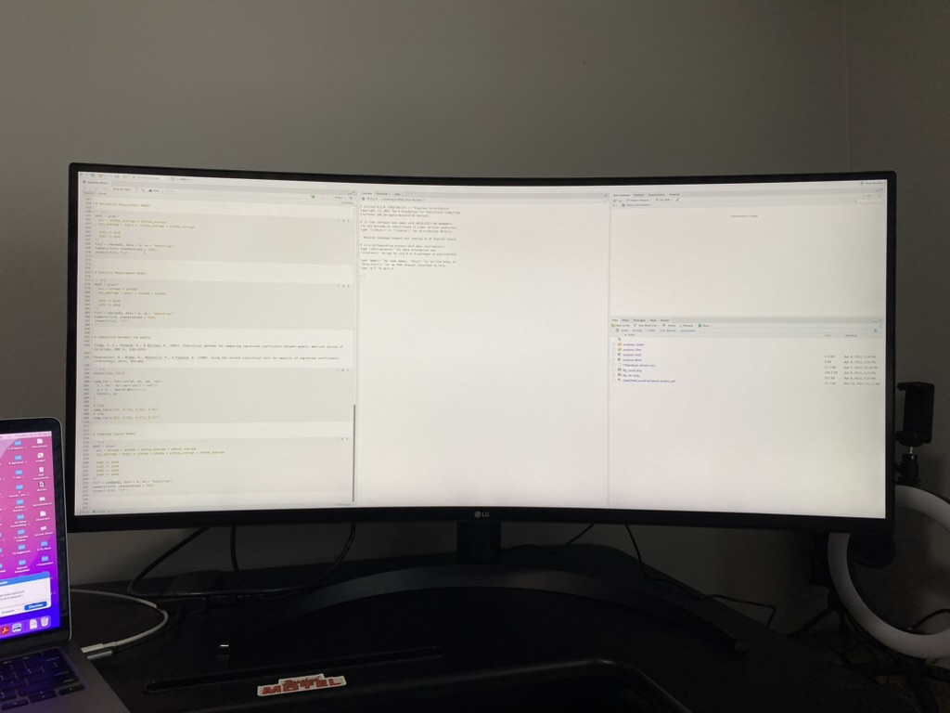
Who
Am
I
?
rfinance(2024L)

Slide 3
Who Else Am I?
Current "maintainer" of data.table
PhD in Quantitative Psychology (Bachelor’s in Economics)
data.table user since 2016, contributor since 2019
Author/maintainer of 6 other R packages (3 on CRAN)
Currently managing a team of researchers at Highmark Health (lots of big data wrangling and cleaning)
CEO of Barrett Evaluation, LLC (big talk for I consult on projects with big data)
rfinance(2024L)

Slide 4
Who are you?
Two truths and a lie
rfinance(2024L)

Slide 5

Agenda
Brief Intro
Keys and Binary Search
Secondary Indices
Programming
Reference Semantics
rfinance(2024L)

Slide 6
Agenda
Brief Intro
Keys and Binary Sort
Secondary Indices
Programming
Reference Semantics
rfinance(2024L)

Slide 7

data.table
Why
?
rfinance(2024L)
Notes:
Why do you use data.table (for those that are using it)?

Slide 8
data.table
Why
?
Concise syntax
Fast speed
Memory efficient
Careful API lifecycle management
Community
Feature rich
Matt’s useR talk from 2014 https://youtu.be/qLrdYhizEMg?t=1m54s
rfinance(2024L)
Notes:
Why data.table? Here’s a few as listed on the data.table README file.

Slide 9
data.table
Why
?
dt[i, j, by]
Concise syntax
Fast speed
Memory efficient
dt[grp == “treatment”, new := mean(x), by = id]
Careful API lifecycle management
dt[dt2, on = “id”]
Community
dt[dt2, on = “id”, roll = TRUE] # rolling joins!
Feature rich
dt[, .N, by = id]
Matt’s useR talk from 2014 https://youtu.be/qLrdYhizEMg?t=1m54s
rfinance(2024L)
Notes:
Why data.table? Here’s a few as listed on the data.table README file.

Slide 10
data.table
Why
?
Concise syntax
Fast speed
Thoughtful and careful so there are very few breaking changes
Can be used in production code safely
Memory efficient
Careful API lifecycle management
Community
Feature rich
Matt’s useR talk from 2014 https://youtu.be/qLrdYhizEMg?t=1m54s
rfinance(2024L)
Notes:
Why data.table? Here’s a few as listed on the data.table README file.

Slide 11
data.table
Why
?
Cool Fact: a data.table containing mostly numeric data can use up to 60% less memory compared to the equivalent data.frame
Concise syntax
Fast speed
Memory efficient
Careful API lifecycle management
Community
Power of all of R + Gforce + grouped optimization (more on this later!)
Feature rich
Matt’s useR talk from 2014 https://youtu.be/qLrdYhizEMg?t=1m54s
rfinance(2024L)
Notes:
Why data.table? Here’s a few as listed on the data.table README file.

Slide 12
Agenda
Brief Intro
Keys and Binary Search
Secondary Indices
Programming
Reference Semantics
rfinance(2024L)

Slide 13
Keys
Kind of like ~~fancy~~ row names
We can set keys on multiple columns and the column can be of different types
integer, numeric, character, factor, integer64, etc.
list and complex types are not supported yet.
Duplicate key values are allowed
Since rows are sorted by key, any duplicates in the key columns will appear consecutively.
Setting a key does two things:
physically reorders the rows of the data.table by the column(s) provided by reference, always in increasing order.
marks those columns as key columns by setting an attribute called sorted to the data.table.
rfinance(2024L)
Notes:
Since the rows are reordered, a data.table can have at most one key because it can not be sorted in more than one way

Slide 14
Keys
Super fast because of binary search (more on this in a moment)
Can be multiple columns, e.g. setkey(dt, var1, var2)
library(data.table)
setkey(dt, var)
# or
setkeyv(dt, "var")
rfinance(2024L)
Notes:
There’s a bunch of set functions in data.table. Anyone know what makes them special?
Why use the setkeyv?
Why would using keys make any difference?

Slide 15
Vector Scan
# example of vector scane
vector_scan_search <- function(arr, target) {
for (i in seq_along(arr)) {
if (arr[i] == target) {
return(i)
}
}
return(-1)
}
# Example usage
vector <- c(1, 3, 5, 7, 9, 11, 13)
target <- 3
result <- vector_scan_search(vector, target)
print(result) # Should print the index of the target in the vector
rfinance(2024L)
Notes:
This is a general search algorithm called “vector scan” which is a good name for what it does
Anyone want to describe what is happening here?

Slide 16
Binary
Search
# example of binary search
binary_search <- function(arr, target) {
left <- 1
right <- length(arr)
while (left <= right) {
mid <- floor((left + right) / 2)
if (arr[mid] == target) {
return(mid)
} else if (arr[mid] < target) {
left <- mid + 1
} else {
right <- mid - 1
}
}
return(-1)
}
# Example usage
sorted_vector <- c(1, 3, 5, 7, 9, 11, 13)
target <- 3
result <- binary_search(sorted_vector, target)
print(result) # Should print the index of the target in the sorted vector
rfinance(2024L)
Notes:
This algorithm (written in R and simplified) is called binary search. This one requires first ensuring the data are ordered. Anyone able to explain what this algorithm is doing?

Slide 17
Binary Search
https://youtu.be/MFhxShGxHWc?si=Ab29czd05h_KfXbh
Cool Fact: data.table shared code with R Core and that has been implemented in R now
rfinance(2024L)

Slide 18
Binary Search
Keys make binary search possible
Can take advantage of it in i, j, by, and on arguments!
EXAMPLE with BTCUSD Time Series
rfinance(2024L)

Slide 19
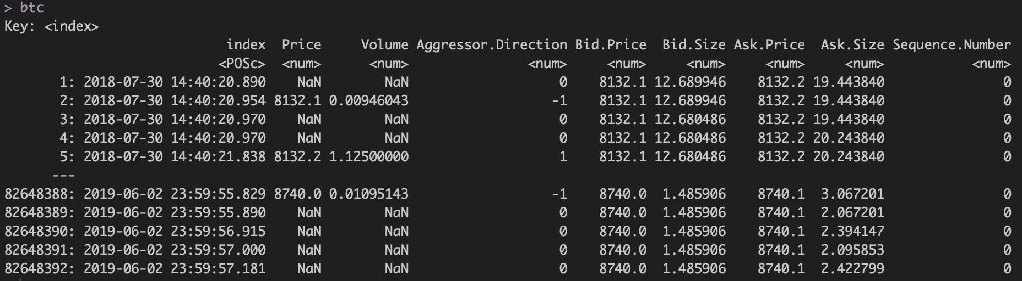
Example BTCUSD
The data were taken from a series of xts objects that were coerced with as.data.table() which has a fast method for xts objects
It automatically takes the index of an xts object and makes it into the first column
rfinance(2024L)

Slide 20
Example BTCUSD
setkey(btc, index)
rfinance(2024L)

Slide 21
Example BTCUSD
# fast search
btc[index < "2018-07-31"]
rfinance(2024L)

Slide 22
library(atime)
sub_timing = atime(
N = c(1e4, 1e5, 1e6, 1e7, 1e8, 1e9),
seconds.limit = .1,
setup = {
set.seed(1)
DT <- data.table(
x1 = rep(c("c","d"), l=N),
x2 = rep(c("x","y"), l=N),
x3 = rep(c("a","b"), l=N),
y = rnorm(N)
)
DT2 = copy(DT)
setkey(DT2, x1)
DF = as.data.frame(DT)
},
dataframe = DF[DF$x1 == "c", ],
datatable = DT[x1 == "c"],
datatable_key = DT2["c"]
)
plot(sub_timing)
rfinance(2024L)

Slide 23
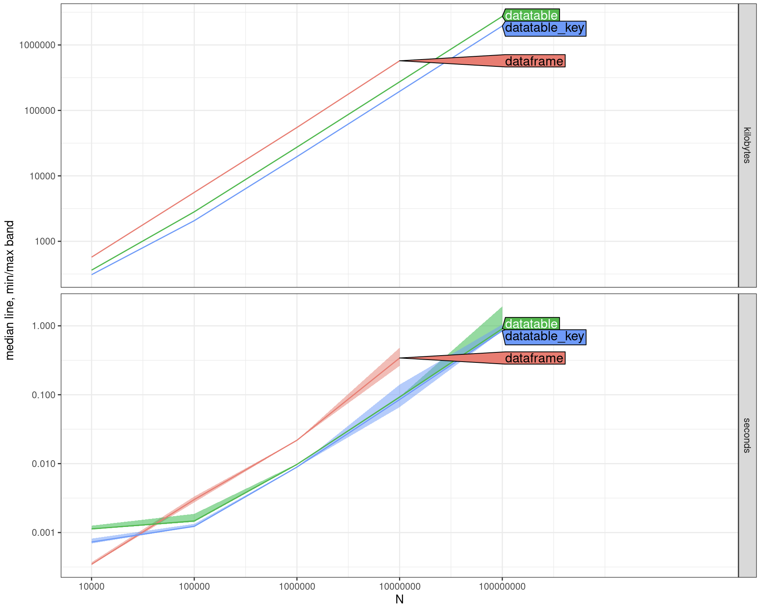
library(atime)
sub_timing = atime(
N = c(1e4, 1e5, 1e6, 1e7, 1e8, 1e9),
seconds.limit = .1,
setup = {
set.seed(1)
DT <- data.table(
x1 = rep(c("c","d"), l=N),
x2 = rep(c("x","y"), l=N),
x3 = rep(c("a","b"), l=N),
y = rnorm(N)
)
DT2 = copy(DT)
setkey(DT2, x1)
DF = as.data.frame(DT)
},
dataframe = DF[DF$x1 == "c", ],
datatable = DT[x1 == "c"],
datatable_key = DT2["c"]
)
plot(sub_timing)
rfinance(2024L)

Slide 24
Agenda
Brief Intro
Keys and Binary Search
Secondary Indices
Programming
Reference Semantics
rfinance(2024L)

Slide 25
Secondary and Auto-Indices
Secondary indices are similar to keys in data.table, except for two major differences:
It doesn’t physically reorder the entire data.table in RAM.
Instead, it only computes the order for the set of columns provided and stores that order vector in an additional attribute called index.
There can be more than one secondary index for a data.table.
Can be useful when ordering a DT is too expensive (even ordering by reference)
Auto-indices are created whenever we use == or %in% in i
rfinance(2024L)

Slide 26
Secondary and Auto-Indices
# set up variable
btc[!is.nan(Price), updown := fcase(Price < shift(Price), "down", default = "up")]
btc["up", on = "updown"]
This statement performs a fast binary search based subset, by computing the index on the fly. However, note that it doesn’t save the index as an attribute automatically.
setindex(btc, updown) # saves as attribute
Create an index formally
rfinance(2024L)

Slide 27
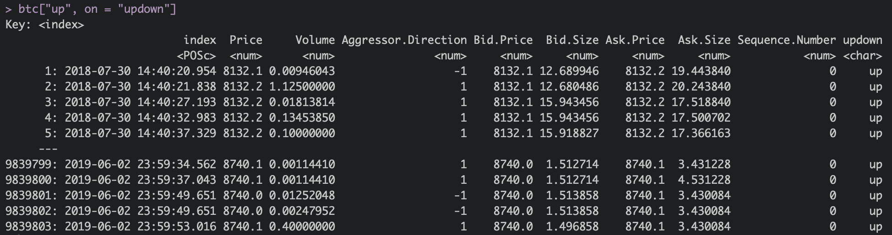
Secondary and Auto-Indices
# set up variable
btc[!is.nan(Price), updown := fcase(Price < shift(Price), "down", default = "up")]
btc["up", on = "updown"]
This statement performs a fast binary search based subset, by computing the index on the fly. However, note that it doesn’t save the index as an attribute automatically.
setindex(btc, updown) # saves as attribute
Create an index formally
rfinance(2024L)

Slide 28
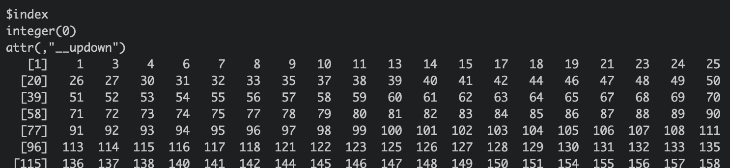
Secondary and Auto-Indices
# auto-index
btc[updown == "down"]
attributes(btc)
rfinance(2024L)

Slide 29
Secondary and Auto-Indices
# first time
tictoc::tic()
btc[updown == "down"]
tictoc::toc()
1.113 sec elapsed
# second time
tictoc::tic()
btc[updown == "down"]
tictoc::toc()
0.16 sec elapsed
Cool Fact: data.table was initially created by Matt Dowle as a way to improve the performance of his own data analysis tasks. He wasn't initially planning to release it as a package, but after sharing it with colleagues and seeing its impact, he decided to make it publicly available.
rfinance(2024L)

Slide 30
Agenda
Brief Intro
Keys and Binary Search
Secondary Indices
Programming
Reference Semantics
rfinance(2024L)

Slide 31
The New env Arg
A recent addition to data.table to help with programming using data.table
Helps with dealing with lazy evaluation problems that can arise using data.table within functions/packages
Makes it possible to avoid eval(parse(…)) code bc of problems:
lack of syntax validation
vulnerability to code injection
the existence of better alternatives
We’ll show substitute2() and [.data.table
rfinance(2024L)

Slide 32
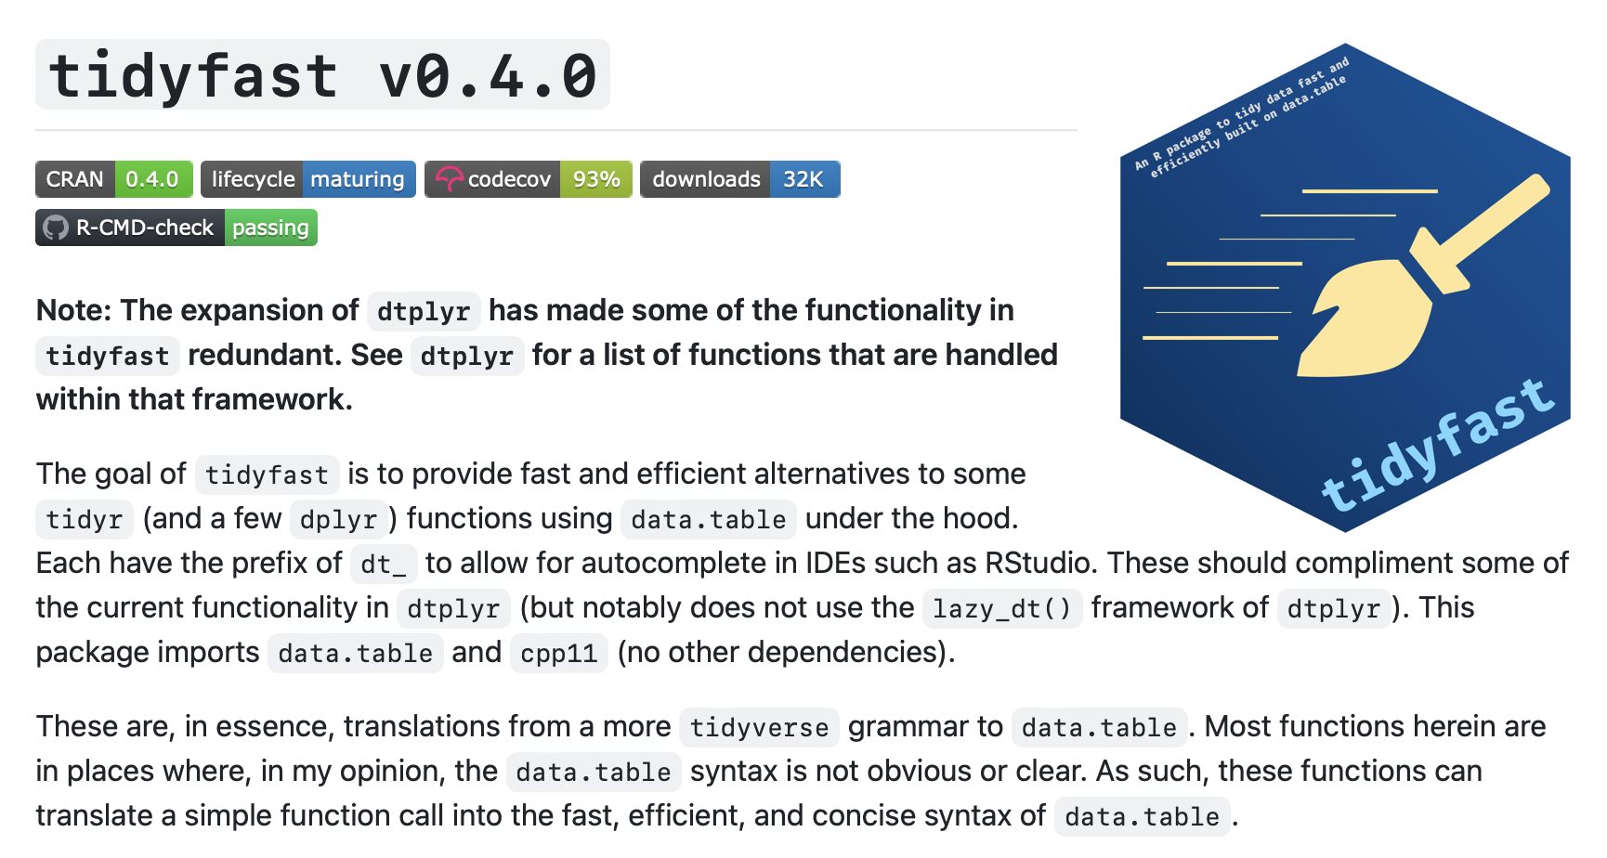
Previous Ways (had limitations)
rfinance(2024L)

Slide 33
Previous Ways (had limitations)
dt_nest.default <- function(dt_, ..., .key = "data") {
# change to data.table
if (isFALSE(is.data.table(dt_))) {
dt_ <- as.data.table(dt_)
}
# groups
by <- substitute(list(...))
# call to data.table
dt_ <- dt_[, list(list(.SD)), keyby = eval(by)]
setnames(dt_, old = "V1", new = .key)
dt_
}
rfinance(2024L)
Notes:
Issues with scoping were most pronounced but also the code was hard to read (https://bookdown.org/rdpeng/rprogdatascience/scoping-rules-of-r.html)

Slide 34
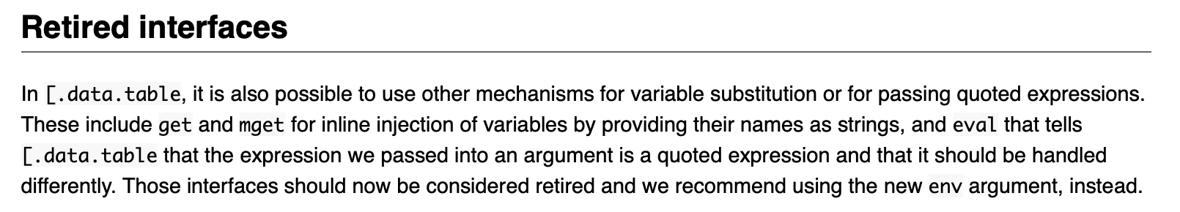
Previous Ways (had limitations)
dt_nest.default <- function(dt_, ..., .key = "data") {
# change to data.table
if (isFALSE(is.data.table(dt_))) {
dt_ <- as.data.table(dt_)
}
# groups
by <- substitute(list(...))
# call to data.table
dt_ <- dt_[, list(list(.SD)), keyby = eval(by)]
setnames(dt_, old = "V1", new = .key)
dt_
}
https://cran.r-project.org/web/packages/data.table/vignettes/datatable-programming.html
rfinance(2024L)

Slide 35
Using env
substitute2(
outer(inner(var1) + inner(var2)),
env = list(outer = "sqrt", inner = "square", var1 = "a", var2 = "b")
)
sqrt(square(a) + square(b))
rfinance(2024L)

Slide 36
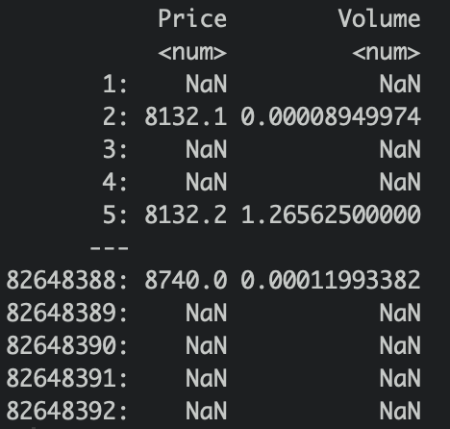
Using env
square = function(x) x^2
btc[, .(var1 = outer(inner(var1)),
var2 = inner(var2)),
env = list(
outer = "sqrt",
inner = "square",
var1 = "Price",
var2 = "Volume"
)]
rfinance(2024L)

Slide 37
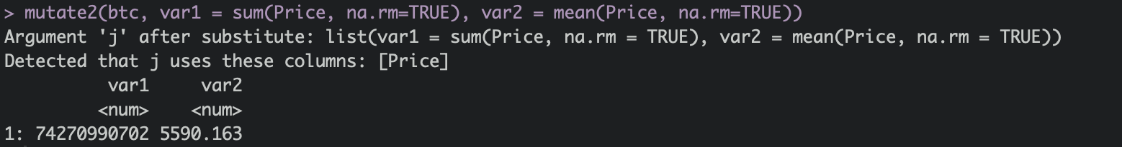
Using env
mutate2 = function(data, ...){
actions = substitute(as.list(...))[-1]
data[, j, env = list(j = as.list(actions)), verbose = TRUE]
}
mutate2(btc,
var1 = sum(Price, na.rm=TRUE),
var2 = mean(Price, na.rm=TRUE)
)
rfinance(2024L)
Notes:
The as.list() is necessary in the env argument to splice the call

Slide 38
Note the Use of Verbose = TRUE
mutate2 = function(data, ...){
actions = substitute(as.list(...))[-1]
data[, j, env = list(j = as.list(actions)), verbose = TRUE]
}
Useful to understand what is happening under the hood of data.table
rfinance(2024L)

Slide 39
Note the Use of Verbose = TRUE
Cool Fact: data.table regularly has >500k downloads per month
mutate2 = function(data, ...){
actions = substitute(as.list(...))[-1]
data[, j, env = list(j = as.list(actions)), verbose = TRUE]
}
Useful to understand what is happening under the hood of data.table
rfinance(2024L)

Slide 40
Agenda
Brief Intro
Keys and Binary Search
Secondary Indices
Programming
Reference Semantics
rfinance(2024L)

Slide 41
Reference Semantics
Allows us to add/update/delete columns of a data.table by reference, and also combine them with i and by.
Passing by Reference: When you pass an argument (like a variable) to a function in a language with reference semantics, you're essentially passing a reference to the original data. This means the function can modify the data directly, impacting the original variable as well.
https://cran.r-project.org/web/packages/data.table/vignettes/datatable-reference-semantics.html
set* functions
:= operator
rfinance(2024L)

Slide 42
DT = data.table(x = 1L, y = 2L)
DT_n = names(DT)
DT_n
# [1] "x" "y"
## add a new column by reference
DT[, z := 3L]
## DT_n also gets updated
DT_n
# [1] "x" "y" "z"
## use `copy()`
DT_n = copy(names(DT))
DT[, w := 4L]
## DT_n doesn't get updated
DT_n
# [1] "x" "y" "z"
Reference Semantics
rfinance(2024L)

Slide 43
Reference Semantics
Can avoid these nuances by using one of the following (note shallow is not exported and may change; plan is to make copy to a shallow copy instead of deep sometime soon)
copy()
data.table:::shallow()
Cool Fact: Reference semantics results from the use of C code as R doesn’t naturally use this style of programming
rfinance(2024L)

Slide 44





Tyson S. Barrett
Thanks to Matt Dowle and Arun Srinivasan and the data.table team!
t.barrett88@gmail.com
tysonbarrett.com
@healthandstats
github.com/tysonstanley
Slides at tysonbarrett.com/teaching
rfinance(2024L)

